Slide 1
Analysis on flipkart mobiles
K.SAI DURGESH
213509
III B.Sc MSCS-1

Slide 2
CONTENTS
ABSTRACT
EXISTING SYSTEM
PROMPTS
FUTURE SCOPE
CONCLUSION

Slide 3
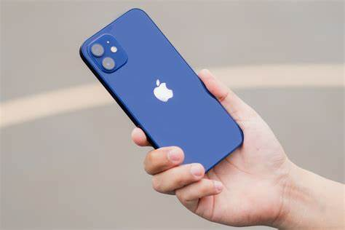
ABSTRACT
In this study, we delve into the world of mobile phones available on Flipkart, one of India’s leading e-commerce platforms. Our analysis focuses on several key aspects:
Mobile Model
Price
Color
Rating

Slide 4
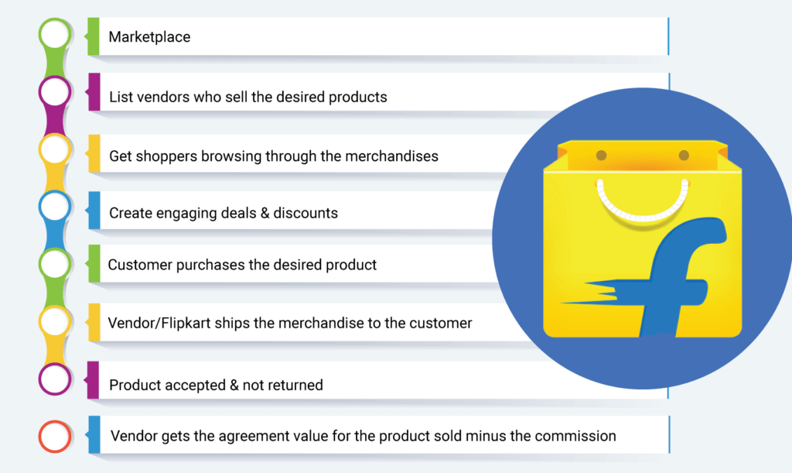
EXISTING SYSTEM

Slide 5
PROMPTS
What are the Most Commonly colors offered by all Mobile Brands?
Which mobile brand has most product offerings in Indian Market?
What is the average price of all Types of Mobiles?

Slide 6
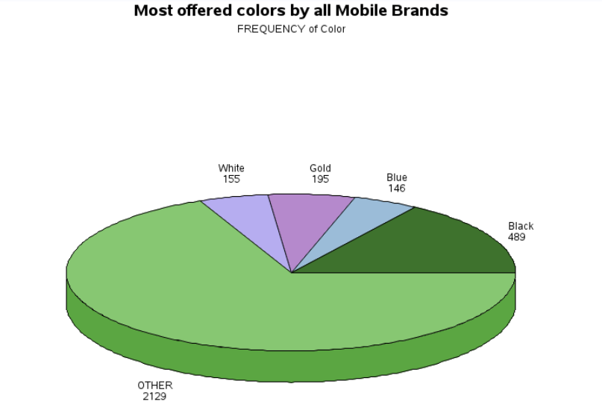
What are the Most Commonly colors offered by all Mobile Brands?

Slide 7
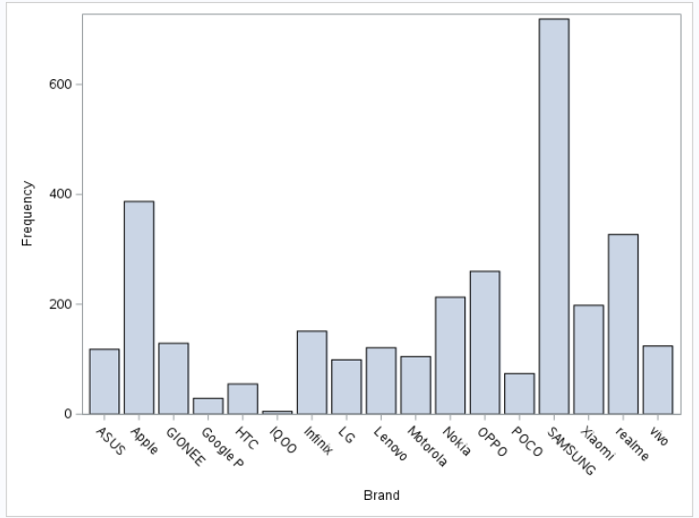
Which mobile brand has most product offerings in Indian Market?

Slide 8
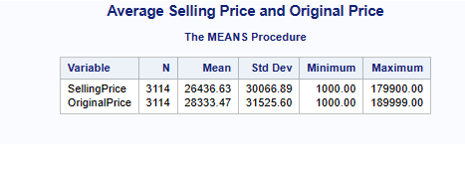
What is the average price of all Types of Mobiles?

Slide 9
FUTURE SCOPE
Technology and Innovation
Market Reach
Strategic Investments
Mobile-Centric Approach

Slide 10
CONCLUSION
We can say that, Samsung mobile brand has most product offerings in Indian Market.
Black Color mobiles were mostly offered by all mobile brands.
The Average Price of the mobiles in flipkart is around Rs.27,000/-

Slide 11
THANK YOU!

